Slide 1
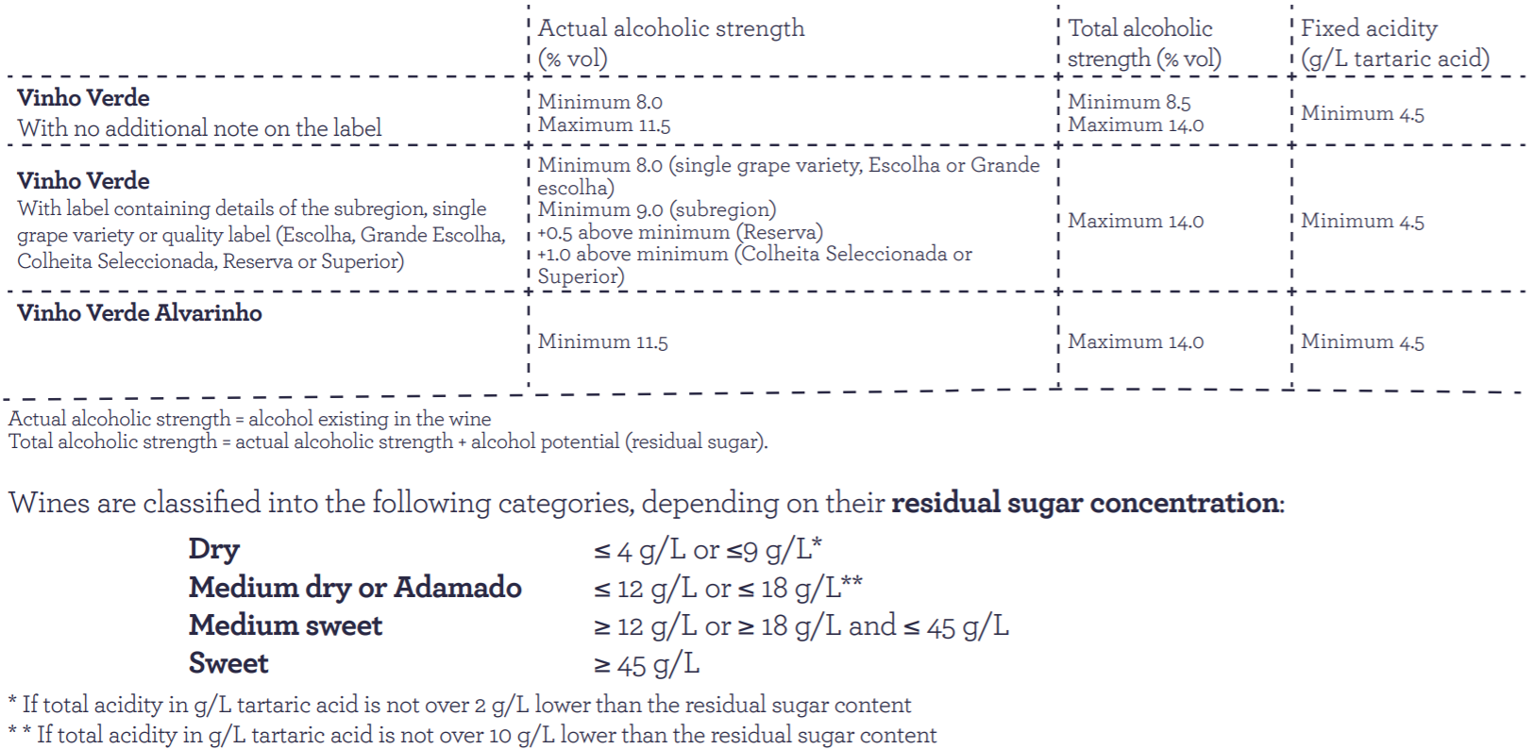
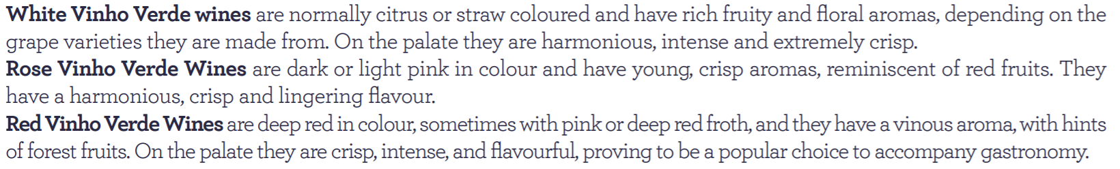
Background & Context
Chemical Profile
Wine is an alcoholic beverage made from grapes fermented without the addition of sugars, acids, enzymes, water, or other nutrients. Yeast consumes the sugar in the grapes and converts it to ethanol and carbon dioxide. Different varieties of grapes and strains of yeasts produce different styles of wine.
These variations result from the complex interactions between the biochemical development of the grape, the reactions involved in fermentation, the terroir, and the production process.
Many countries enact legal appellations intended to define styles and qualities of wine. “Vinho Verde” is a unique product from North Portugal governed by The Vinho Verde Region Viticulture Commission.
One of the requirements necessary for certification with the “Vinho Verde” DO is the physical, chemical and sensorial characteristics. Vinho Verde has a number of different chemical profiles distinguished by grape variety, indication of the subregion and quality labels.
Sensory Profile
http://www.vinhoverde.pt/en/file/517
https://en.wikipedia.org/wiki/Wine

Slide 2
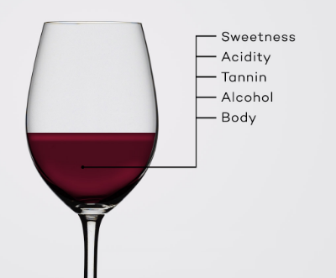

Background & Context
5 Basic Characteristics of Wine:
Sweetness: How sweet or dry (not sweet) is the wine?
Acidity: How tart is the wine?
Tannin: How astringent or bitter is the wine?
Alcohol: How much does the wine warm your throat?
Body: Light to Full-Bodied?
There is a science to winemaking, and there are many factors that make a quality wine, so how do we determine if we have a quality wine?
.
Our Task
Using the white vinho verde wine samples from Portugal, identify which physicochemical properties make a quality wine.

Slide 3
Analytical Solution
Research Question: Which physicochemical variables predict the sensory variable?
Data Understanding and Manipulation
Model Development
Validate Model
Test Model Assumptions
Address Problems
Dataset analyzed using linear regression model. Model assessed using ANOVA and Evaluated collinearity, homoscedasticity, and autocorrelated errors.
Model was determined to be unsuitable. Collinearity between certain variables was identified.
Viewed and understood dataset. Transformed dataset to normalize, scale and centre distribution. Identified and removed outliers.
Used automated feature selection to identified the best features suited to determining wine quality. The feature density was removed as this feature had collinearity in second test model.
Model re-assessed using ANOVA and had acceptable levels of collinearity, homoscedasticity or autocorrelated errors.
1
2
3
4
5

Slide 4
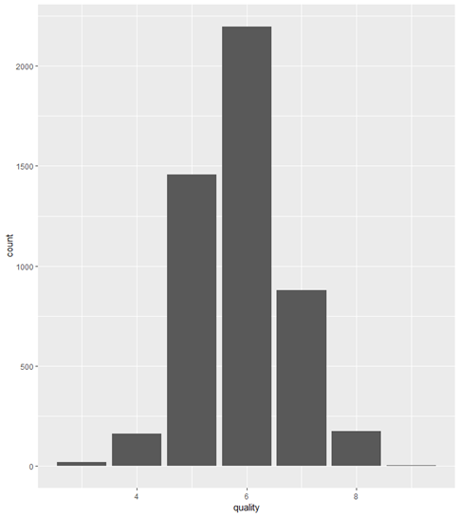
Data Understanding
In the White Wine dataset, there are 11 features (0 categorical, 11 numerical), and 1 Target variable.
Target Variable
quality (int)
Categorical Features
fixed.acidity (num)
volatile.acidity (num)
citric.acid (num)
residual.sugar (num)
chlorides (num)
free.sulfur.dioxide (num)
total.sulfur.dioxide (num)
density (num)
pH (num)
sulphates (num)
alcohol (num)
Distribution of quality shows that majority of quality ratings are between 5 and 6, with few low and high ratings
dataset.url <- "https://archive.ics.uci.edu/ml/machine-learning-databases/wine-quality/winequality-white.csv"

Slide 5
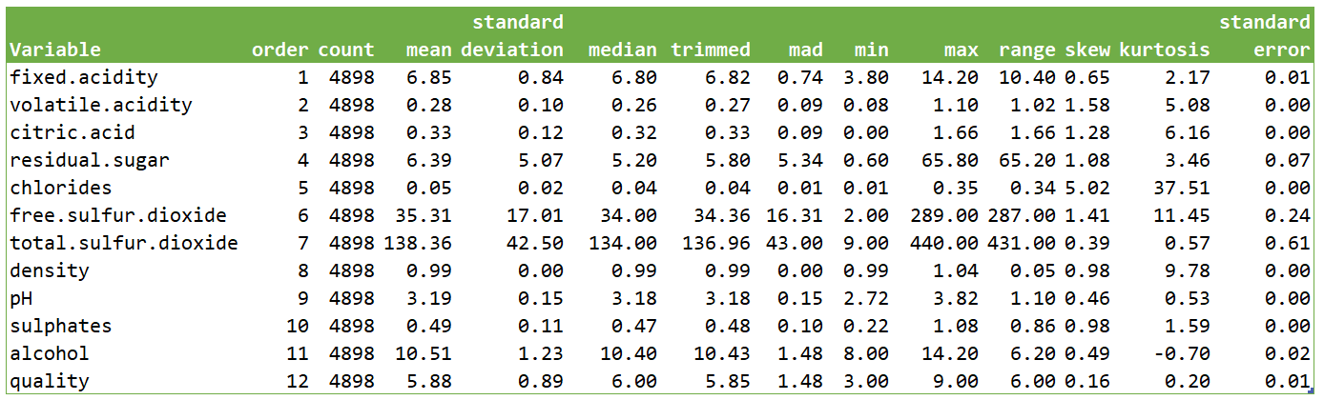
Data Understanding
White Wine: 4898 obs.

Slide 6
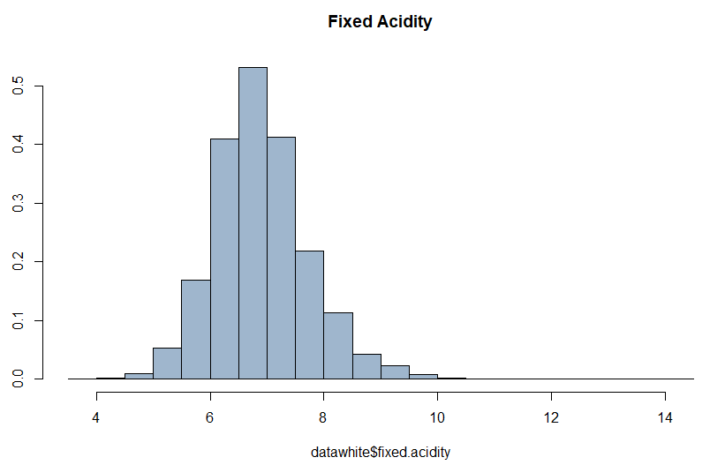
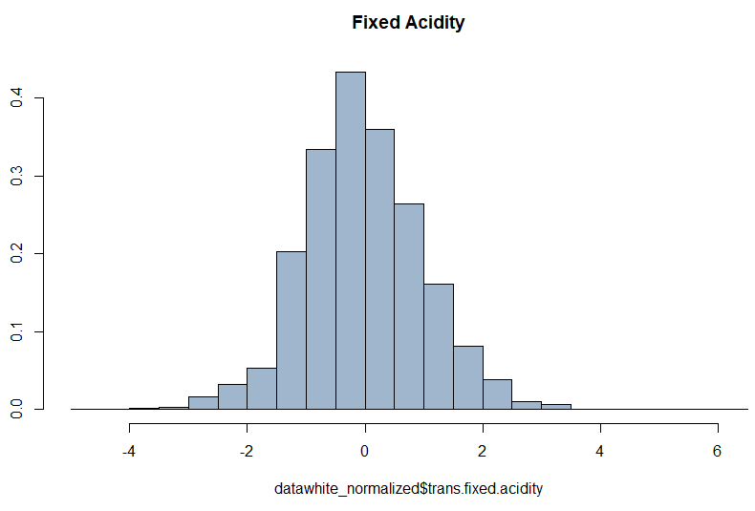
Data Normalization
Normalize, centre and scale the dataset to improve the fit of the model and Correct for possible statistical assumptions such as homogeneity, heteroskedasticity and normal distribution of errors, etc.
datawhite_raw = preProcess(datawhite[,1:11],c("BoxCox","center","scale"))
datawhite_normalized = data.frame(trans = predict(datawhite_raw, datawhite))
Pre-Transformation
Post-Transformation

Slide 7
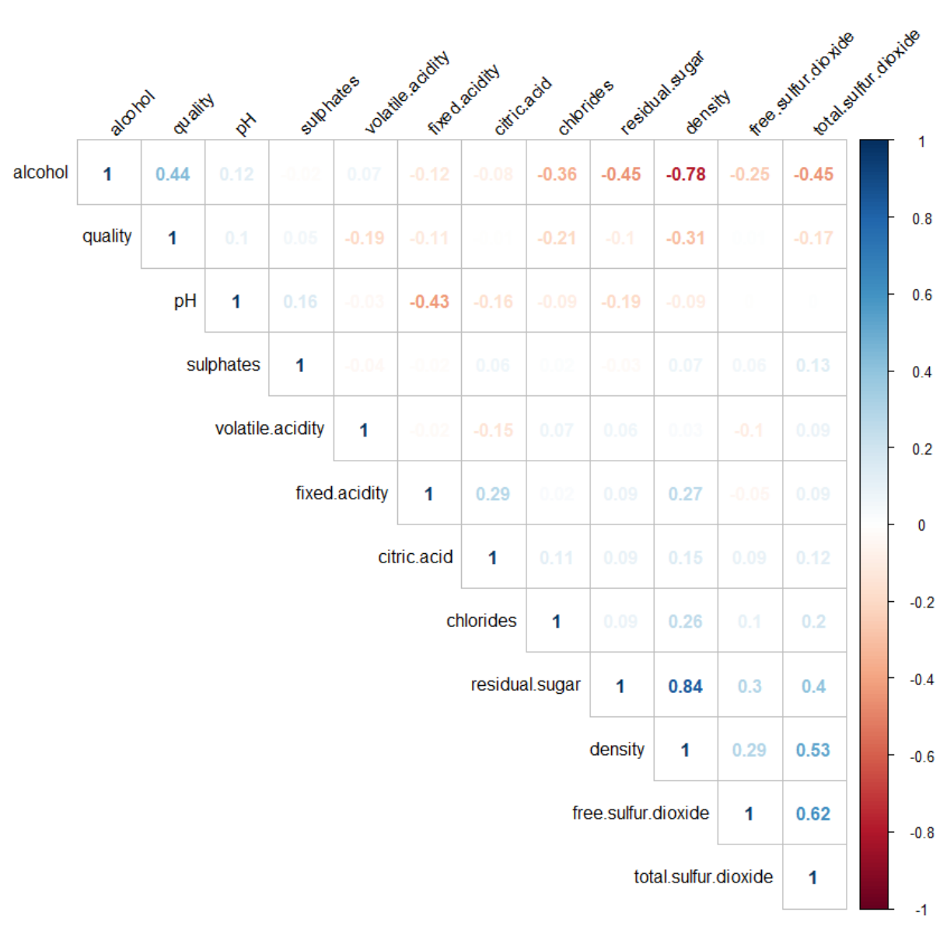
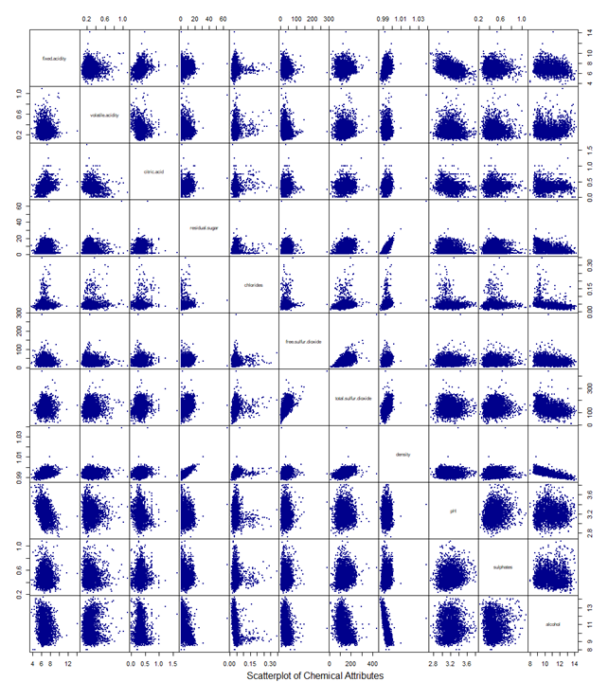
Data Exploration:
Correlation
residual.sugar and density have a high positive correlation
alcohol and density have a high negative correlation

Slide 8
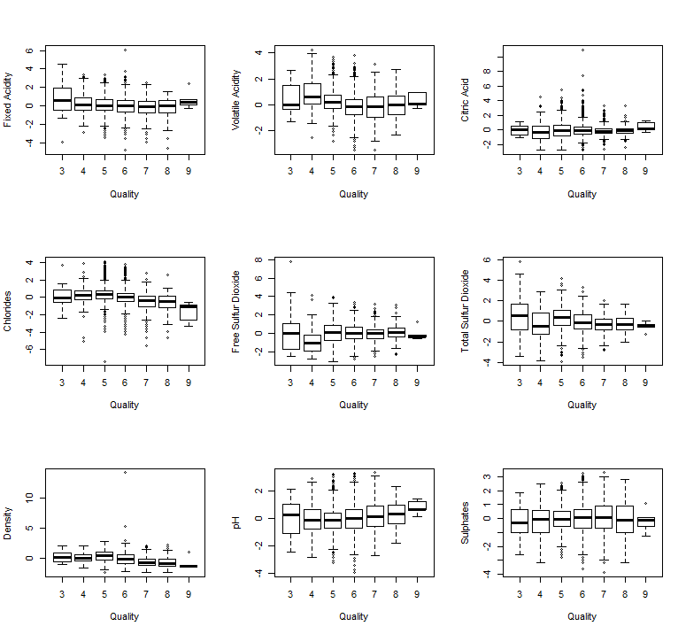
Data Exploration:
Outliers
Based on boxplot analysis of each variable by the target variable, some outliers are seen on the following variables:
Fixed Acidity
Volatile Acidity
Citric Acid
Chlorides
Free Sulfur Dioxide
Total Sulfur Dioxide
Density
PH
Sulfates

Slide 9
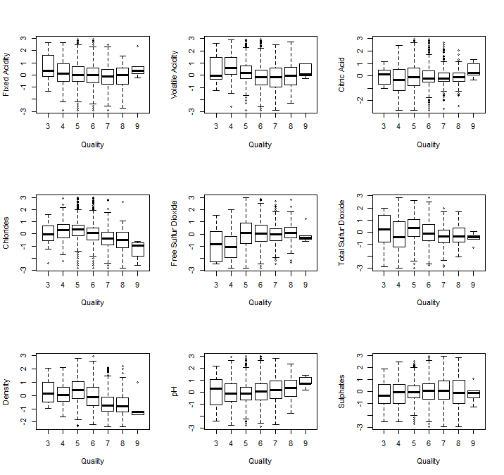
Data Preparation:
Removing Outliers
After scaling and identifying the features that contain outliers, we removed all outliers that are greater than 3 standard deviations.
#Remove outliers
datawhite_norm = datawhite_normalized [!abs(datawhite_normalized$trans.fixed.acidity)>3,]
datawhite_norm = datawhite_normalized [!abs(datawhite_normalized$trans.volatile.acidity)>3,]
datawhite_norm = datawhite_normalized [!abs(datawhite_normalized$trans.citric.acid)>3,]
...

Slide 10
Model Development
Several models are created with different combinations.
Here are examples:
Model 1 : White_lm_full=lm(formula = trans.quality ~ . - trans.quality, data = datawhite_normalized, na.action = na.omit)
Coefficients:
Estimate Std. Error t value Pr(>|t|) (Intercept) 5.877909 0.010756 546.470 < 2e-16 *** trans.fixed.acidity 0.009129 0.014889 0.613 0.539831 trans.volatile.acidity -0.186517 0.011439 -16.306 < 2e-16 *** trans.citric.acid 0.010611 0.011511 0.922 0.356641 trans.residual.sugar 0.262295 0.022667 11.572 < 2e-16 *** trans.chlorides -0.045495 0.012926 -3.520 0.000436 *** trans.free.sulfur.dioxide 0.122317 0.014551 8.406 < 2e-16 *** trans.total.sulfur.dioxide -0.051932 0.016371 -3.172 0.001522 ** trans.density -0.234774 0.035095 -6.690 2.49e-11 *** trans.pH 0.053335 0.013775 3.872 0.000109 *** trans.sulphates 0.060913 0.011307 5.387 7.49e-08 *** trans.alcohol 0.286633 0.023541 12.176 < 2e-16 ***
Residual standard error: 0.7528 on 4886 degrees of freedom Multiple R-squared: 0.2792, Adjusted R-squared: 0.2775 F-statistic: 172 on 11 and 4886 DF, p-value: < 2.2e-16

Slide 11
Model Evaluation
Model 1 Test:
sqrt(vif(White_lm_full)) #Evaluate Collinearity
fixed.acidity volatile.acidity citric.acid residual.sugar alcohol sulphates 1.384109 1.063337 1.070039 2.107153 2.188426 1.051098 chlorides free.sulfur.dioxide total.sulfur.dioxide density pH 1.201631 1.352708 1.521829 3.262486 1.280551
ncvTest(White_lm_full) #Evaluate homoscedasticity
Non-constant Variance Score Test Variance formula: ~ fitted.values Chisquare = 2.388269 Df = 1 p = 0.1222489
durbinWatsonTest(White_lm_full) #Test for Autocorrelated Errors
lag Autocorrelation D-W Statistic p-value 1 0.1877736 1.624232 0 Alternative hypothesis: rho != 0
Model 1 Summary:
All variables are input in this model
Collinearity exists in the model
Notes:
Evaluated collinearity, homoscedasticity, and autocorrelated errors.

Slide 12
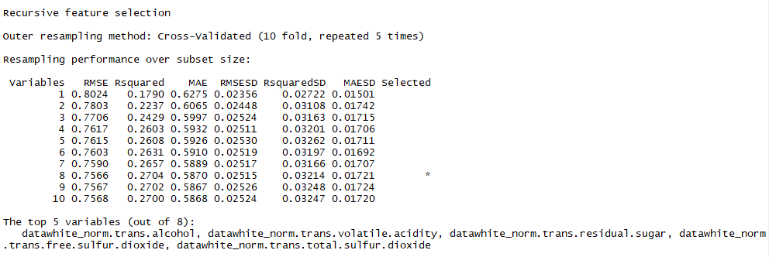
Data Preparation: Automated Feature Selection
Since the results of Model 1 were inconclusive, we utilized a Recursive Feature Elimination algorithm to identify the features in our dataset that are most important to determining wine quality. The density column was removed as it had high collinearity.
control = rfeControl(method = "repeatedcv", repeats = 5, verbose = TRUE, functions = lmFuncs)
whitewineRFE = rfe(x = datawhite_norm[,1:11], y = datawhite_norm[,12], sizes = c(1:11), metrix = "RMSE", rfeControl = control)
print(whitewineRFE)
importance <- varImp(whitewineRFE, scale=FALSE)
print(importance
Top 5 Variables:
Alcohol
Volatile Acidity
Residual Sugar
Free SO₂
Total SO₂

Slide 13
Model Development
Model 2:
lm(formula = trans.quality ~ trans.alcohol + trans.residual.sugar +
trans.free.sulfur.dioxide + trans.total.sulfur.dioxide, data = datawhite_normalized,
na.action = na.omit)
Coefficients:
(Intercept) 5.87791 0.01116 526.645 < 2e-16 ***
trans.alcohol 0.41218 0.01312 31.415 < 2e-16 ***
trans.residual.sugar 0.10412 0.01291 8.064 9.17e-16 ***
trans.free.sulfur.dioxide 0.19411 0.01441 13.474 < 2e-16 ***
trans.total.sulfur.dioxide -0.12143 0.01579 -7.692 1.74e-14 ***
Residual standard error: 0.7811 on 4893 degrees of freedom
Multiple R-squared: 0.2228, Adjusted R-squared: 0.2221
F-statistic: 350.6 on 4 and 4893 DF, p-value: < 2.2e-16

Slide 14
Model Evaluation
Model 2 Test:
sqrt(vif(White_lm_10)) #Evaluate Collinearity trans.alcohol trans.residual.sugar trans.total.sulfur.dioxide
1.175432 1.156723 1.416664
trans.free.sulfur.dioxide
1.290978
ncvTest(White_lm_10) #Evaluate Heteroscedasticity Non-constant Variance Score Test
Variance formula: ~ fitted.values
Chisquare = 1.380148 Df = 1 p = 0.2400759
durbinWatsonTest(White_lm_10) #Test for Autocorrelated Errors lag Autocorrelation D-W Statistic p-value
1 0.1791219 1.641638 0
Alternative hypothesis: rho != 0
Model 2 Summary:
Volatile Acidity has a 1.44 t value, so we remove it from our model.
Collinearity does not exists in the model.
Heteroscedasticity not exists
Autocorrelation not exists
Multiple R-squared only 0.2231

Slide 15
Outcome
In both instances, our models produced a R² value between the ranges of 22% - 28%; However, Low R² squared values are not inherently bad. In models meant to predict human behaviour, usually an R² value under 50% can be expected. Our target variable of wine quality is definitely a subjective measure, as this factor measures a generalization of wine profile preferences. Our RMSE values ranged around 78% which indicates the absolute fit of our model is relatively strong, thus validating model to some degree.
Our models still demonstrate significant coefficients which can be useful for determining the quality of wine.

